Slide 1
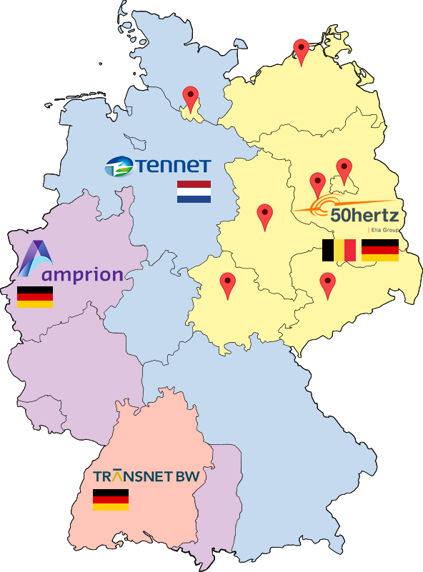
Main consumers:
Berlin
Brandenburg
Hamburg
Mecklenburg-Western
Pomerania
Saxony
Saxony-Anhalt
Thuringia

Slide 2
Weather
Air temperature
Atmospheric pressure
Relative humidity
Wind speed
Total cloud cover;
Horizontal visibility

Slide 3
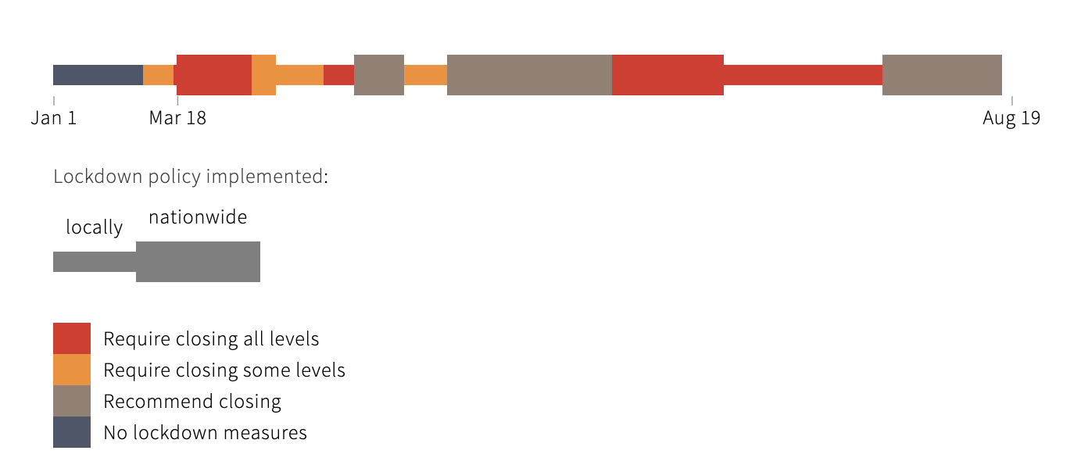
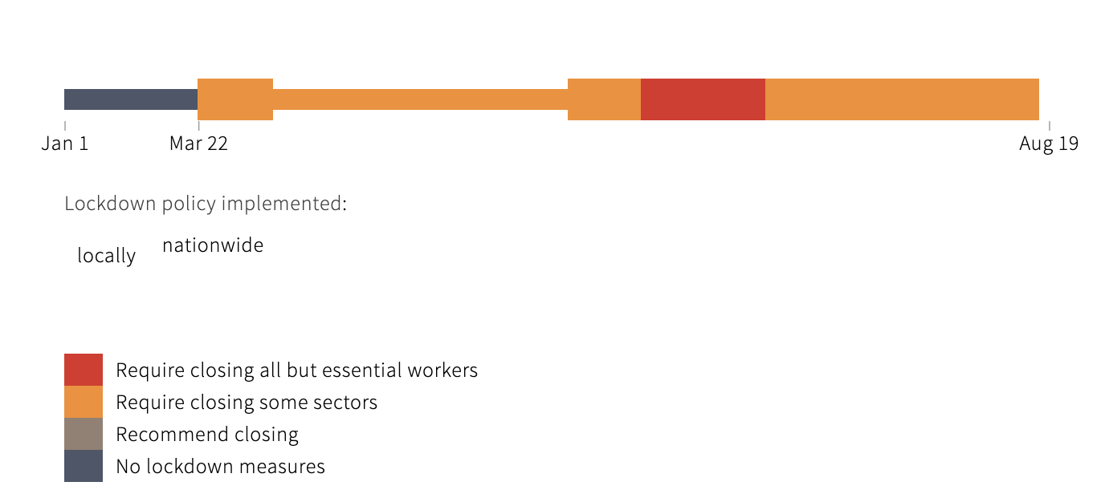
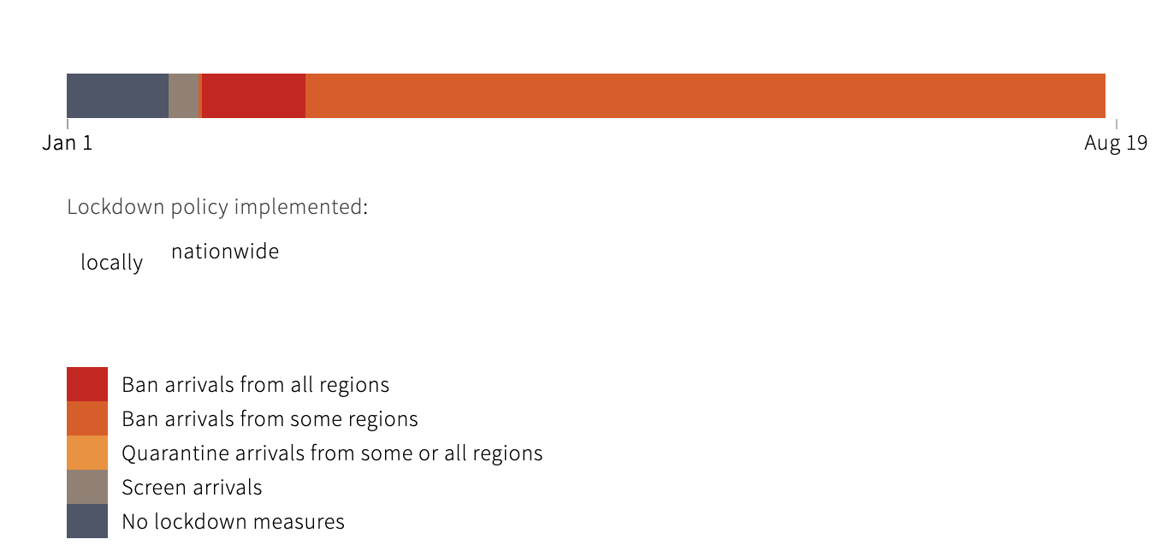
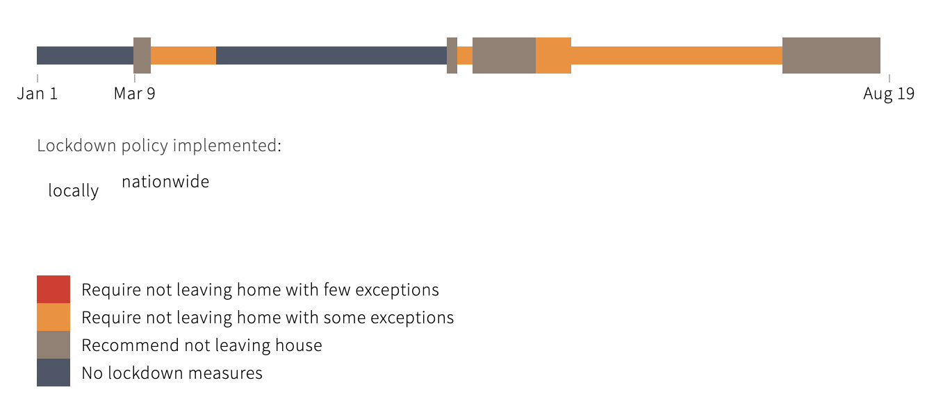
Lockdown

Slide 4
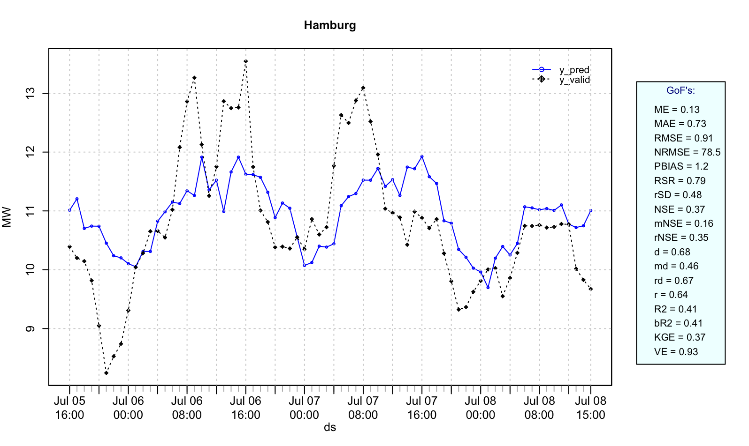
Prophet
MSE | RMSE | MAE | MAPE | CP | KGE
0.8354067 | 0.9140059 | 0.7296678 | 0.06794679 | -2.030819 | 0.3694624

Slide 5
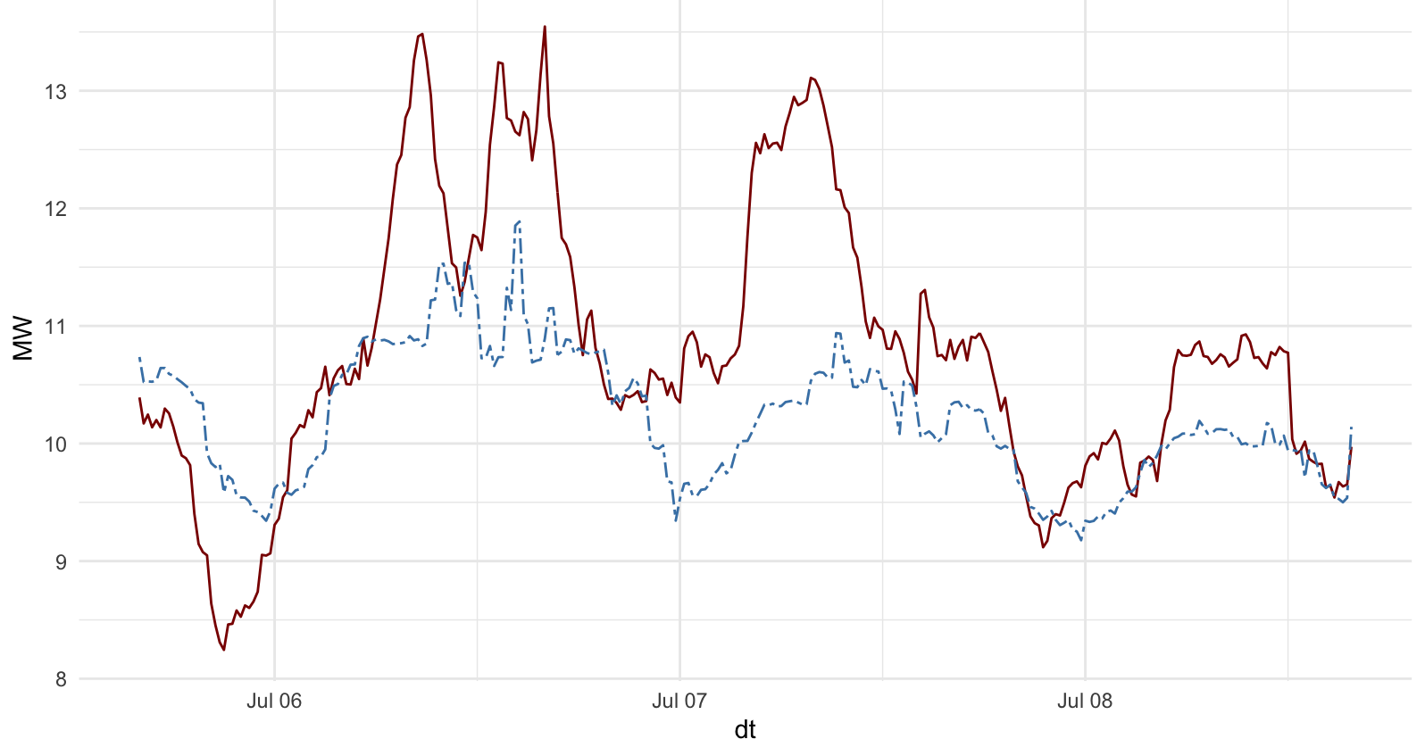
H20, gbm
MSE | RMSE | MAE | MAPE | CP | KGE
1.01897 | 1.009441 | 0.7424915 | 0.06541719 | -2.713066 | 0.3866464

